Slide 1

Faculty of Applied Engineering and Urban Planning
Civil Engineering Department
Dr. Eng. Mustafa Maher Al-tayeb
2 Semester 2022/2023
Probabilistic and Statistical

Slide 2
Statistics for Describing, Exploring,
and
Comparing
Data
Measures
Measures
of
of
Variation
Position

Slide 3
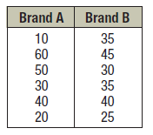
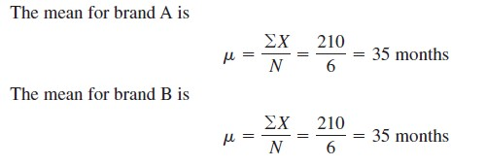
A testing lab wishes to test two experimental brands of outdoor paint to see
how long each will last before fading. The testing lab makes 6 gallons of each paint to test. Since different chemical agents are added to each group and only six cans are involved, these two groups constitute two small
populations. The results (in months) are shown. Find the mean
of each group.

Slide 4
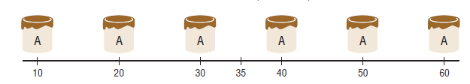
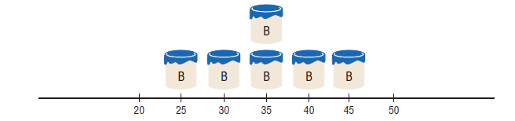
As below Figures shows, even though the means
brands, the spread, or variation, is quite different.
are
the
same
for
both

Slide 5
Measures of
Definition
Variation
The range of a set of data is the difference between
maximum value and the minimum value.
the
Range = (maximum value) – (minimum value)
The range is very easy to compute but because it depends
only the highest and the lowest values, it isn't as useful as
other measures of variation that use every value.
on
the

Slide 6
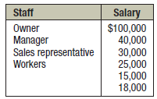
Ex. The salaries for the staff of
the
XYZ
Manufacturing
Co.
are
shown
here.
Find
the
range.
Solution:
The range
is R = $100,000 - $15,000
= $85,000.

Slide 7
Probabilistic and Statistical Techniques
Definition
The variance of a set of values is a measure of variation equal to the square of the standard deviation.
Sample variance S²: Square of the sample standard deviation
Population variance : Square of the population standard deviation

Slide 8
Sample Standard Deviation
The standard deviation of a set of sample values
a measure of variation of values about the mean.
is
Sample
Standard
Deviation Formula

Slide 9
Sample Standard Deviation
(Shortcut Formula)
9

Slide 10
Population
Standard
Deviation
This
formula
is
similar
to
the
previous
formula,
but
instead, the population mean and population
size are used

Slide 11
Standard Deviation -
Important Properties
❖ The standard deviation is a measure of variation of all values
from the mean.
The value of the standard deviation s is usually positive.
❖ The value of the standard deviation S can increase
dramatically with the inclusion of
one or more
outliers
(data
values far away from
all others).
❖ The
units
of
the
standard
deviation
S
are
the
same as the units
of the original data values.

Slide 12
Example
For the data
set
determine:
Standard deviation
Data Set I :
41
44
45
47
47
48
51
53
58
66
x
_{x}2
Solution
41
1681
44
1936
(x² )− (
x) ²
∑ ∑
n
45
2025
s =
47
2209
n(n −1)
47
2209
2
48
2304
10(25494) − 500
s =
= 7.4
51
2601
10(9)
53
2809
58
3364
66
4356
Sum
500
25494

Slide 13

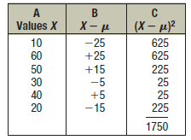
Example
For the population data set
determine:
Standard
deviation
Data Set II
:
10
60
50
30
40
20
Solution
σ = ¹⁷⁵⁰ = 17.1
6

Slide 14
Standard deviation from a
Frequency Distribution
use
class
midpoint of classes for variable
Class Mid point
x
(x − x )² . f
∑
s =
n −1

Slide 15
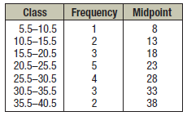
Ex. Find the sample variance and the sample standard deviation
for
the
the frequency distribution of
show data, The data represent
number
of
miles
that
20
runners
ran
during
one
week.

Slide 16
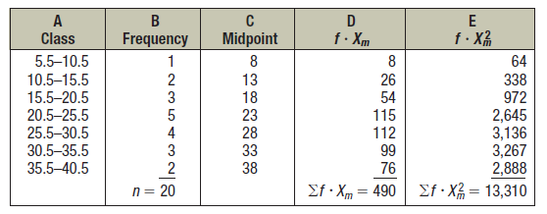
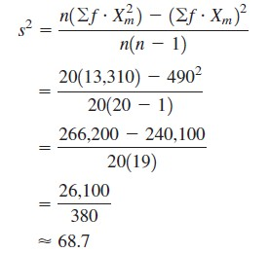

Solution:
sample variance
sample
standard
deviation

Slide 17
Definition
The
coefficient
of
variation (or
CVar)
for a
set
of
sample
or
population
data,
expressed
as
a
percent,
describes the standard
deviation
relative to the mean.
Sample
Population
_{CVar =} ^{s} _{×100}
x
CVar = ^{σ} ×100
μ

Slide 18
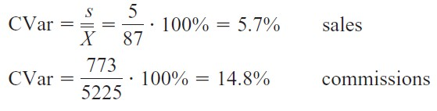
Example
The mean
of the
number
of sales
of cars over
a
3-month
period is 87, and the standard deviation is
commissions is $5225, and the standard
Compare the variations of the two.
5. The mean
of the
$773.
deviation
is
Solution:
The coefficients of variation are
Since the coefficient of variation
the commissions are more variable
is larger for commissions,
than the sales.

Slide 19
Definitions
Median
The middle value when the original data values
are
arranged
in
order
of
increasing
(or
decreasing)
magnitude
is not
affected by
an extreme value

Slide 20
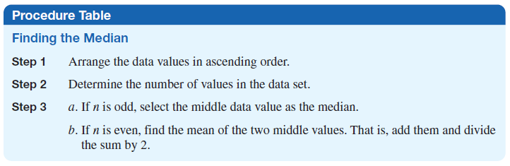

Slide 21
5.40
1.10
0.42
0.73
0.73 0.48
1.10 1.10
1.10
5.40
0.42 0.48
(in order - even number of values – no exact middle
shared by two numbers)
MEDIAN is
0.73 + 1.10
=
0.915
2

Slide 22
5.40
0.42
1.10
0.48
0.42
0.66
0.73
0.73
0.48
1.10
1.10
1.10
0.66
5.40
(in order - odd number of values)
MEDIAN
is
0.73

Slide 23
Properties of
the Median
1. The median is used to find the center or middle value of
a data set.
2. The median
is
used
when
it is
necessary
to find out
whether the data values fall into the upper half
half of the distribution.
or lower
3. The median is used for an open-ended distribution.
4. The median is affected less than the mean by extremely high or extremely low values.

Slide 24
Definitions
Mode
The value that occurs most frequently
❖ Mode is not always unique
❖ A data set may be:
Bimodal
Multimodal
No Mode
23

Slide 25
A data set that has only one value that occurs with the
frequency is said to be unimodal.
greatest
If a data set has two values that occur with the same
frequency, both values are considered to be the mode and set is said to be bimodal.
greatest
the data
If a data set has more than two values that occur with the same
greatest frequency, each value is used as the mode, and the data set is said to be multimodal.
When no data value occurs
have no mode.
more than once, the data set is said to

Slide 26
Mode
- Examples
a.
5.40
1.10
0.42
0.73
0.48
1.10
⇦
⇦
⇦
Mode is 1.10
b.
27
27
27
55
55
55
88
88
99
Bimodal -
27
&
55
c.
1
2
3
6
7
8
9
10
No Mode

Slide 27

Ex 1:The data show the number of licensed nuclear reactors
in
the
United States for a recent 15-year period.
Find
the mode.
Solution: The modes are 104 and 109.
bimodal.
The
data set is
said
to
be
Ex 2:The number of accidental deaths due to firearms for a six-year
period is shown. Find the mode.
600 ,610 ,613 ,642 ,789 ,649
Solution :Since each value occurs only once, there is no mode.

Slide 28
Definition
❖ Midrange
The
midrange
is
defined
as
the
sum
of the
lowest
and
highest values in the
data set,
divided by 2.
lowest
value + highest
value
Midrange =
2

Slide 29

EX. The number of bank failures for
a
recent
five-year
period is shown.
Find the midrange.
71
,157
,148
,30
,3
Solution:

Slide 30
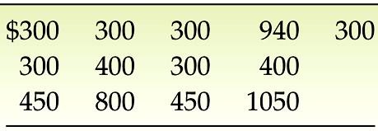
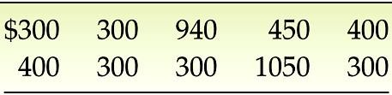
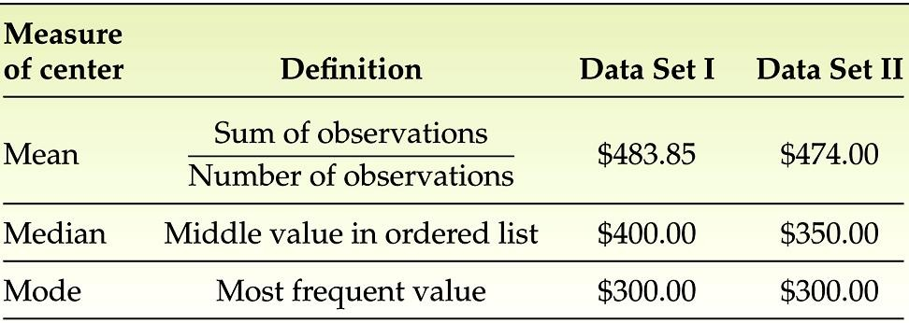
For each data
set
determine: Mean
Median
Mode
Midrange
Table 3.1
Data Set I
Table
3.2
Data
Set
II
Solution

Slide 31
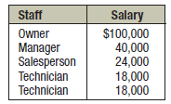
Ex:
A
small
company
consists
of
the
owner,
whose
the
manager,
the
are
salesperson,
listed here.
and two technicians,
all
of
annual
salaries
Find the mean,
median, and mode.
Solution:
The
mean
is
$40,000,
the
median
is
$24,000, and
the
mode
is
$18,000.

Slide 32
The weighted mean
The weighted mean is a special case of the arithmetic mean. It occurs when there are several observations
of
the same value. To explain, suppose we
want
to
9,
compute the mean for the following values:
9,
9,
12.5, 12.5, 12.5, 12.5, 15,
15, 15,
Weighted mean = (3*9
= 12.2
+4*12.5
+ 3*15) / 10

Slide 33
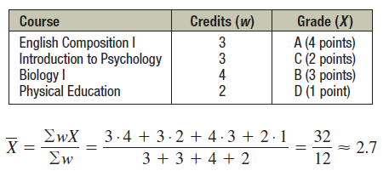
The weighted mean
A student received an A in English Composition I (3 credits), a C in Introduction to Psychology (3 credits), a B in Biology I (4 credits), and a D in Physical Education (2 credits). Assuming A = 4 grade points, B =
3 grade points, C = 2 grade points, D = 1 grade
point,
and
F
=
0
grade
points,
find
the
student’s
grade
point
average.

Slide 34
Distribution Shapes
❖ Symmetric
distribution of data is symmetric if the left half of
its histogram is roughly a mirror image of
half
❖ Skewed
its right
distribution
symmetric and other
of data
is
skewed if
it
is not
than the
if it extends more to one side

Slide 35
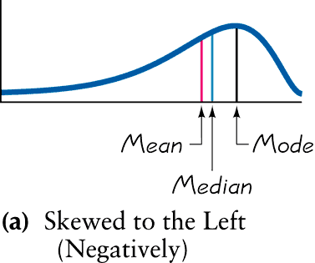
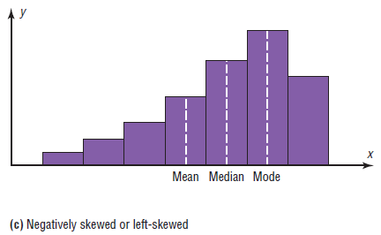
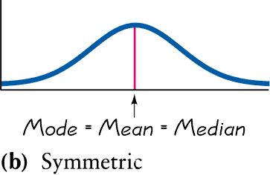
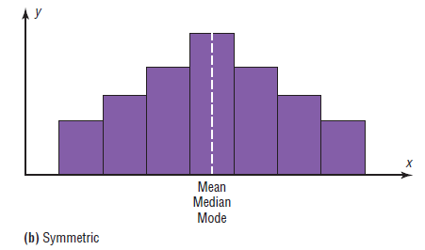
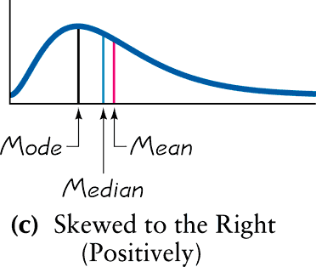
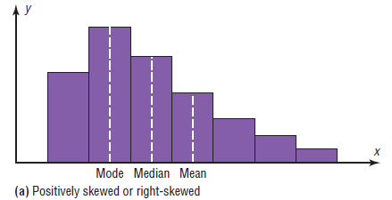

Slide 36
Probabilistic and Statistical Techniques
Estimation of Standard Deviation
For estimating a value of the standard deviation s,
Use
Where range = (maximum value) – (minimum value)

Slide 37
Probabilistic and Statistical Techniques
Range Rule of Thumb
For Interpretation: If the standard deviation is known, we can use it to find rough estimates of the minimum and maximum ‘usual’ sample values as follows:
minimum usual value (mean) - 2 * (standard deviation)
maximum usual value (mean) + 2 * (standard deviation)

Slide 38
Probabilistic and Statistical Techniques
Example
Results from the National Health survey show that the heights of men have a mean of 69 in and a standard deviation of 2.8 in. use the range rule of thumb to find the minimum and maximum usual heights.
minimum usual value = (mean) - 2 * (standard deviation)
= 69 -2*2.8 = 63.4 in
maximum usual value = (mean) + 2 * (standard deviation)
= 69+2*2.8 = 74.6 in

Slide 39
Probabilistic and Statistical Techniques
Chebyshev Theorem
The proportion (fraction) of any set of data lying within K standard deviations of the mean is always at least 1-1/K² , where K is any positive number greater than 1. For K= 2 and K= 3, we get the following results.
At least 3/4 of the values lie within 2 s.d. of the mean
At least 8/9 of the values lie within 3 s.d. of the mean

Slide 40
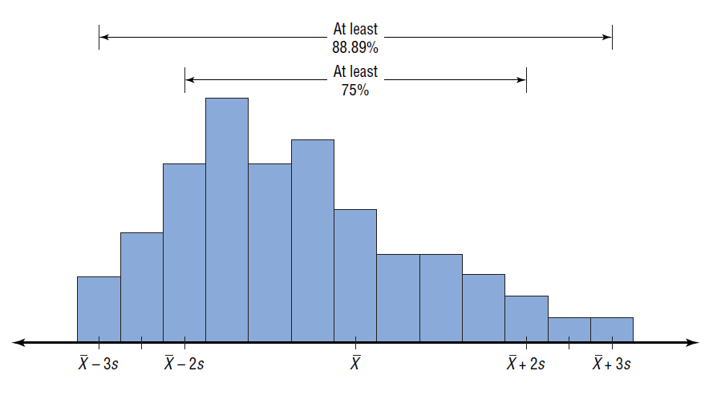
This
theorem
can
be
applied
to
any
distribution
regardless
of
its
shape

Slide 41
Example
The mean price of houses in a certain neighborhood is $50,000, and the standard deviation is $10,000. Find the price range for which at least 75% of the houses will sell.
Solution:
Chebyshev’s theorem states that 75%, of the
within 2 standard deviations of the mean.
data values will fall
$50,000 + 2($10,000) = $70,000
and
$50,000 - 2($10,000) = $30,000
Hence, at least 75% of all homes sold in price range from $30,000 to $70,000.
the area will have a

Slide 42
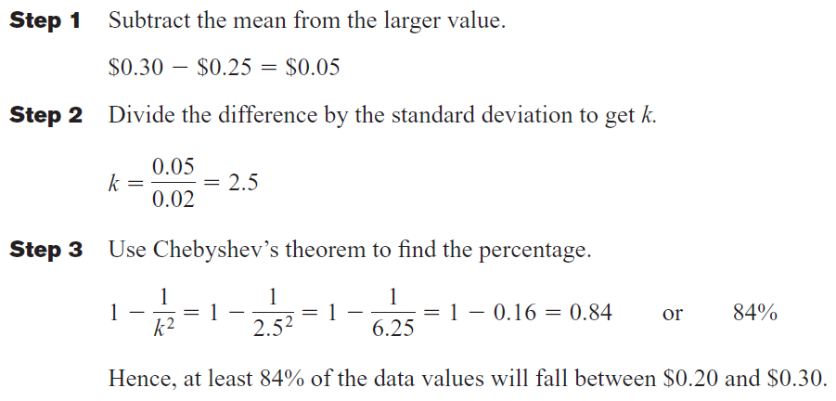
Example
A survey of local companies found that the mean amount of
travel
allowance
for
executives
was $0.25
per
mile.
The
standard
deviation
was
$0.02.
Using
Chebyshev’s
theorem,
find the minimum
percentage
$0.30.
of
the
data
values
that
will
fall
between $0.20
Solution:
and

Slide 43
Probabilistic and Statistical Techniques
Definition
Empirical Rule
For data sets having a distribution that is approximately bell shaped, the following properties apply:
About 68% of all values fall within 1 standard deviation of the mean.
About 95% of all values fall within 2 standard deviations of the mean.
About 99.7% of all values fall within 3 standard deviations of the mean.

Slide 44
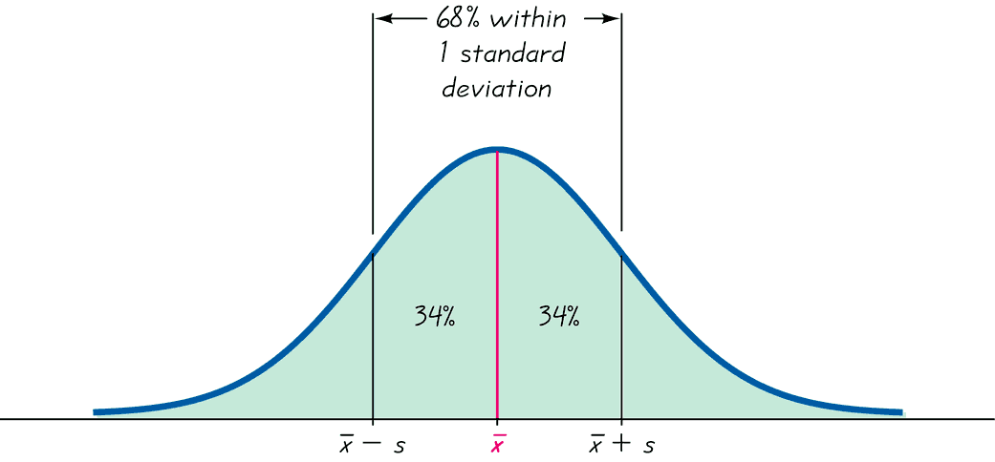
Probabilistic and Statistical Techniques
The Empirical Rule

Slide 45
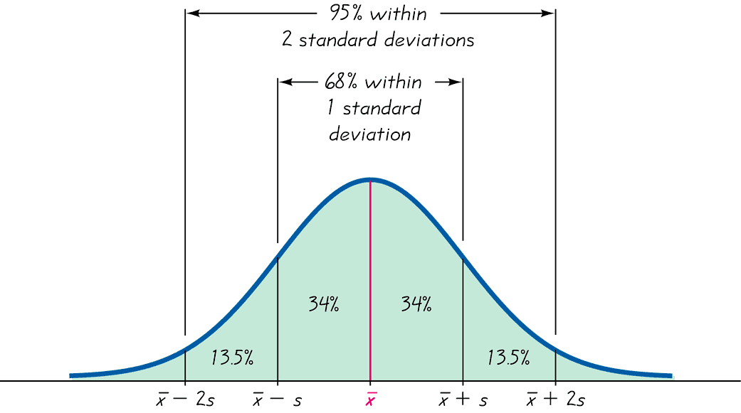
Probabilistic and Statistical Techniques
The Empirical Rule

Slide 46
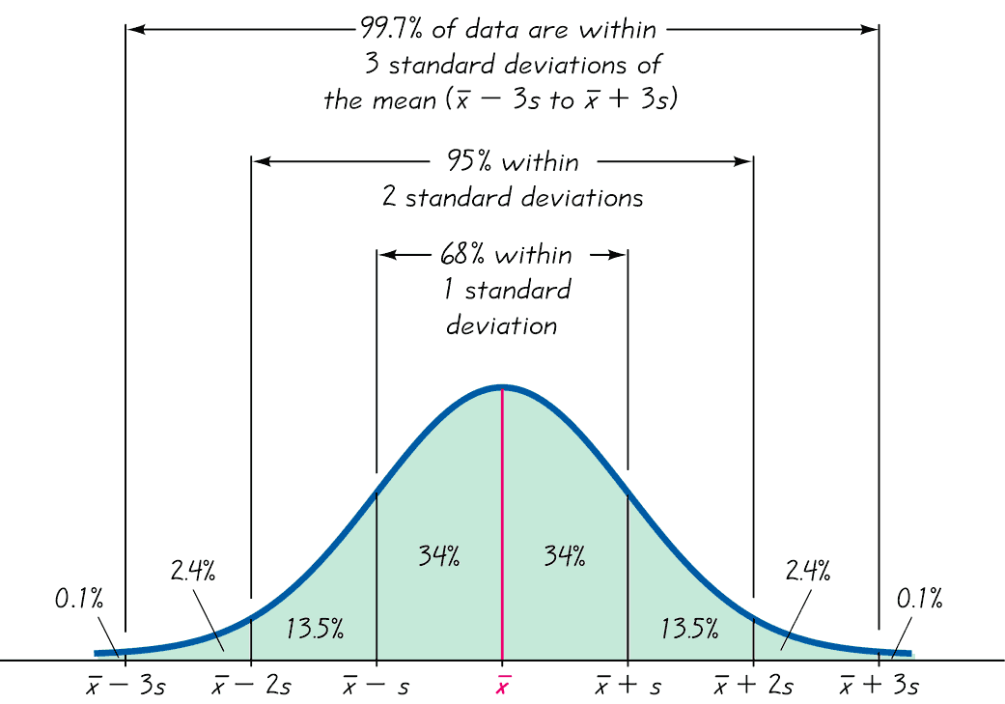
Probabilistic and Statistical Techniques
The Empirical Rule

Slide 47

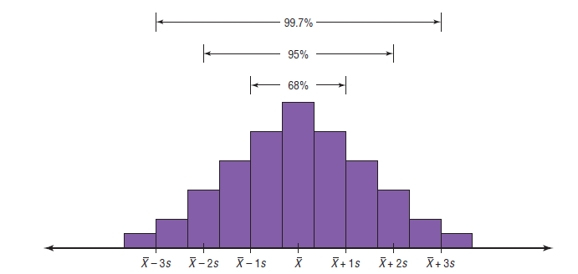
The
Empirical
Rule

Slide 48
For example, suppose that the scores on a national achievement exam have a
mean of 480 and a standard deviation of 90. If these scores are
distributed, then
-Approximately 68% will fall between 390 and 570
(480 + 90 = 570 and 480 - 90 = 390).
-Approximately 95% of the scores will fall between 300 and 660.
(480 + 2*90 = 660 and 480 – 2*90 = 300).
-Approximately 99.7% will fall between 210 and 750.
(480 + 3*90 = 750 and 480 – 3*90 = 210).
normally

